Slide 1
Virginia Tech Policy for Mobile Communication Devices
Business Practices Seminar
April 9, 2015
Joe Belcher and Meghan Seifert

Slide 2
MCD Discussion Items
MCD Policy – Effective July 1, 2015 (Upon MDS Final Approval)
Procedures - Including Mobile Communication Device Best Practices
MCD Request Form - maintained in your departmental files
P3A-F or P3A-S Form - submitted to Human Resources
Training Documents to be posted on the Controller’s Office Website:
Flow Chart
Captivate Online Training Module

Slide 3
Policy
Purpose is to provide guidance and establish parameters regarding the issuance and use of mobile communication devices and services
Two Options Available:
University Provided Device and Service Plan
Reimbursement for Business Use of Personal Device and Service Plan
Defines departmental and employee responsibilities as they pertain to each option

Slide 4
Procedures
Illustration of allowance / reimbursement calculation
Details the processes and procedures that support the policy and provides guidance for departments
Mobile Communication Device Best Practices are also included:
General Security
Transmission Security
Application and Data Security

Slide 5
Request Form
Must be completed and maintained within the department. Does NOT go to payroll or HR
Signed by employee and department head to acknowledge responsibilities
Used when issuing an option, changing an option, or terminating an option
Contains sections for
Employee Information & Request Type
Business-Use Justification, Option Selection, and Required Documentation (if applicable)
Operating Parameters
Certification Statements and Signatures

Slide 6
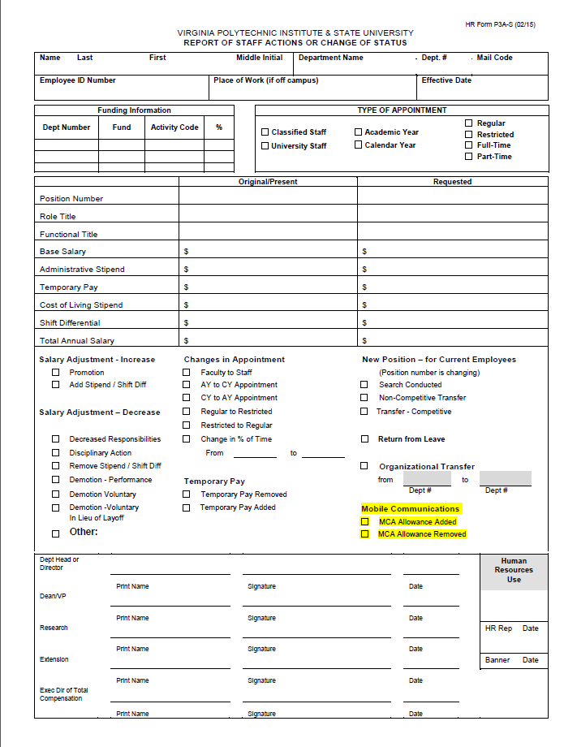
P3A-S and P3A-F Forms
Must be completed to start or terminate an allowance (when not automatically terminated by a banner job code change)
Must be submitted to Human Resources by December 24th in order to prevent annual termination of an allowance

Slide 7
Points to Note
Policy charges the Department Head with determining the business need for an MCD
Five categories of qualification for an MCD
Selection of appropriate MCD option and/ or plan should be a joint decision between the department head and employee
Recognition of de minimis personal use of a university-provided device and plan as personal use that does not exceed the calling and / or data plan.
Employees must reimburse the university for any additional charges incurred due to the personal use of a university-provided device that exceeds the provided calling and/or data plan.

Slide 8
Points to Note
Allowance / Reimbursement is Tax-Exempt
Departments / Employees must comply with all documentation requirements in order to maintain tax-exempt status with the IRS
Allowance / Reimbursement Automatically terminates:
At the end of each calendar year, regardless of when it began, if a new P3A-S or P3A-F form is not submitted to HR by December 24th
When there are position changes or terminations that result in a change in Banner code since the allowance is tied to the employee code in Banner

Slide 9
Points to Note
Calculation of the monthly allowance / reimbursement amounts will be reviewed annually by the Controller’s Office
Request forms are to be maintained within your department
Best Practices are provided to secure both personal and university provided devices. Highlights include:
Mobile devices should be password protected
Do not leave your mobile device unattended in public locations
Connect through VT-Wireless or Virginia Tech’s VPN service, when available
Do not install software from unknown sources
Lost, stolen, or misplaced mobile devices should be immediately reported to the Virginia Tech Police and your department head or designee.

Slide 10
Training/Resources
Flow chart will be available to provide a visual guide as to the steps taken to initiate, change, or terminate an option.
An online training video has also been developed to assist departments in smooth implementation
Procedures, Request Form, Flow Chart, and Captivate Online Training Module will be posted on the Controller’s Office Website and, of course, accessible via the DBMP.

Slide 11
Questions???
Thank You and Have a Nice Day!

